Slide 1
Recovery and Wellness
Module 2
Notes:
Trainer Manual
Module 02: Recovery and Wellness © 2023 PeerWorks
This training program is designed to be accessible to all trainers, and ensure that all participants receive the same quality of education regardless of specific trainers’ background and experience.
This manual is a living document and should be understood as a set of guidelines, not as a fixed script. Feel free to adapt the language to your style of presentation. We also recognize that language is always changing; please update terminology when necessary. The synchronous sessions should be dynamic, engaging experiences.
TRAINER
“Hello, everyone, and welcome back to PeerWorks Core Competencies Training. It’s so nice to see everyone again. Module 2 is ‘Recovery and Wellness.’ This module has two names to acknowledge the different languages that everyone has for their personal lived experiences. As before, my name is_____. Let’s start with our land acknowledgement.”

Slide 2
Land Acknowledgement
Module 2 – Recovery and Wellness
[ADD TRAINER’S LAND ACKNOWLEDGEMENT HERE]
Notes:
TRAINER’S LAND ACKNOWLEDGEMENT

Slide 3
Poll
Module 2 – Recovery and Wellness
Notes:
TRAINER
“Before we begin, we want to do a quick check-in about the homework. The poll will come up on the screen.”
Please read out the poll question and the poll results.
(COORDINATOR) Launch Zoom Poll asking:
The homework took me:
Less than 30 minutes
30 - 45 minutes
45 - 60 minutes.
Over an hour.

Slide 4

Housekeeping
Module 2 – Recovery and Wellness
Please mute yourself if you are not speaking.
Feel free to include your pronouns in your Zoom Name.
Use Zoom reaction tools, chat box, hands up, etc.
Be prepared to have video on at all times; as such, please be appropriately dressed and limit distractions.
Contribute to the conversations out loud and in the chat box.
If someone has already shared what you were going to say, lower your hand and put “agree” in the chat.
Notes:
COORDINATOR
Read out Housekeeping slide.

Slide 5
Expectations
Module 2 – Recovery and Wellness
Arrive on time.
Help us create a confidential, non-judgmental space (no screenshots or recordings).
Please keep your phones on silent.
Avoid cross-talk and side-talk.
Learn from each person’s perspective.
Language – please bring new language to us as we recognize that language is ever-changing.
Have fun!
From the group:
[ADD PARTICIPANT ADDITIONS, IF ANY]
Notes:
COORDINATOR
Read out Expectations slide.
“The first part of the homework was to reflect on our expectations and bring forward anything that you would like to add or alter. Now that we’ve had this time to reflect, what do you think could be added to our Expectations?”

Slide 6

Icebreaker Activity
Module 2 – Recovery and Wellness
What is your name?
Would you rather cook dinner or do the dishes?
Notes:
TRAINER
“Now for our second ice breaker: Would you rather cook dinner or do the dishes?”
As the trainers, feel free to go first. Keep it brief and thank people for sharing.

Slide 7
Module Overview
Module 2 – Recovery and Wellness
In Module 2 we will be discussing Recovery/Wellness.
Our understanding of Recovery/Wellness regarding Mental Health and Addictions is from the perspective of Peer Supporters, as opposed to a traditional bio-medical perspective. During this module, we will discuss and explain this distinction.
We will consider the meaning of the word Recovery/Wellness from your perspective and the perspective of your Peers within the Training Session and beyond.
We will consider the role of Peer Supporters in inspiring Peers’ Recovery/Wellness.
Notes:
COORDINATOR
Read the Module Overview and the Learning Objectives out loud.

Slide 8
Learning Objectives
Module 2 – Recovery and Wellness
Through the successful completion of Module 2, you will be able to:
Define Recovery/Wellness
Identify the Seven Dimensions of Wellness and describe how to influence them positively.
Illustrate the role of Peer Supporters in supporting Recovery within the context of Mental Health and Addiction.
Notes:
COORDINATOR
Read the Module Overview and the Learning Objectives out loud.

Slide 9
Pre-module Homework
Module 2 – Recovery and Wellness
Notes:
TRAINER
“Part of the homework for today’s class was to read two personal stories from Christian and Tanya. What was your experience of reading these two stories?”
“While no one is required to share their life story during these training sessions, the work of a Peer Supporter involves listening and sharing. Throughout the modules we will read the written stories that Peers and Peer Supporters have shared with us, and also hear some of these stories through video shares. We hope that these videos and readings will demonstrate that there isn’t just one way to share. People share their lived experiences in a variety of different ways and that’s part of what makes Peer Support such an incredible and supportive field: we recognize that everyone is unique and brings something specific and special to their work.”

Slide 10
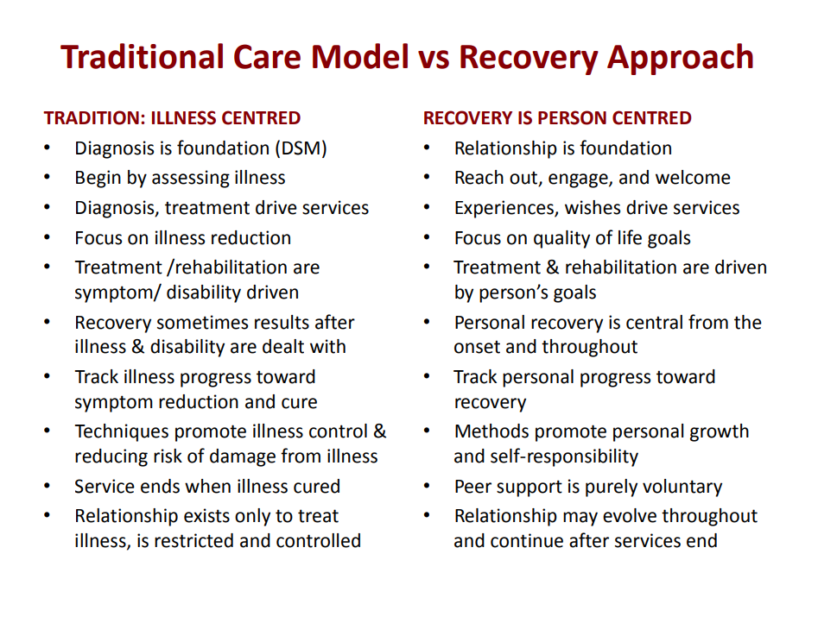
Table from Deb Sherman and Allan Strong’s presentation, “Integrating Peer Support with Integrity”(2017) https://www.peerworks.ca/de/cache/modules_listing/280/rs_recovery-webinar-jan2017-eng.pdf
Notes:
TRAINER
“This slide complements the paper by Mark Ragins as it explains the difference between an illness-centered approach and a person-centered approach. One of the foundations of Peer Support is a focus on the person. As you might remember from our last session, the language of people and relationships was one of the focuses of our definitions of Peer Support.”
Go through the chart with the class.

Slide 11
Individual Activity
Module 2 – Recovery and Wellness
Take 5 minutes and reflect on what you’ve read in the homework and compile your own definition of Recovery/Wellness. It doesn’t have to be formal. Consider what recovery means to you and how you would articulate that to a peer.
Be prepared to share your definition with the whole group. You will submit this as part of your homework
Notes:
TRAINER
Read the instructions for the individual activity. Give the group five minutes to craft this definition. If it seems like they need extra time, offer two more minutes. Likewise, if they look like they finish early, ask them if they are all ready to share and stop the clock early.
Invite everyone to share their definition. Remind them that part of the exercise is in articulating “recovery/wellness” to a Peer. Does this change how they articulate their definition? If so, how?

Slide 12

RECOVERY: “a process of change through which individuals improve their health and wellness, live a self-directed life, and strive to reach their full potential.”
- Suicide and Mental Health Services Administration https://www.samhsa.gov/find-help/recovery
“Recovery is hard work and it requires personal agency, will, vision, hope, fortitude, courage, imagination, commitment and resilience.”
- Patricia Deegan
Module 2 – Recovery and Wellness
Notes:
TRAINER
Invite someone to read the two definitions of recovery.
At this point you should be halfway through the allotted time.

Slide 13
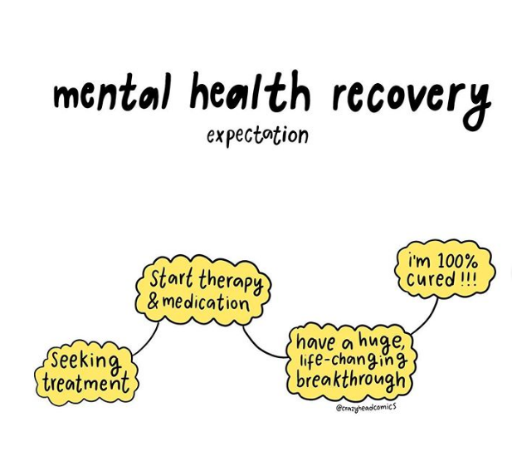
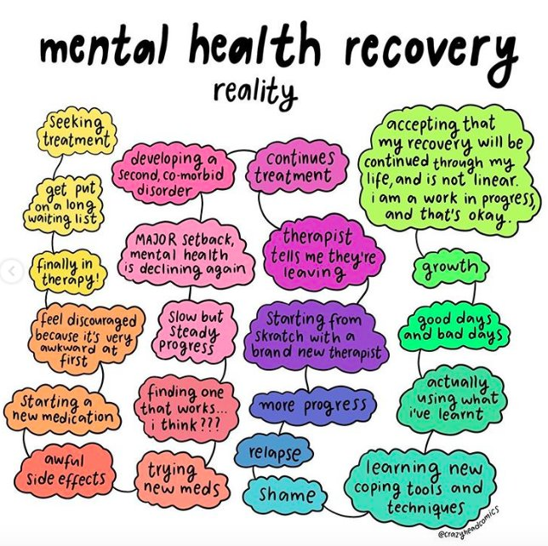
From @crazyheadcomics on Instagram
Notes:
TRAINER
Read the comic out loud.
“Wellness is a continuum and it is not linear. Though this comic is titled Mental Health Recovery, the same can be said for Addictions. In fact, many times the two intersect.”
Invite people to share the language they choose around their Recovery/Wellness (if it hasn’t already come up).
“Different people gravitate towards different language to describe their lived experiences. Be mindful of the language someone chooses when engaging in Peer Support work.
Some of us might never consider ourselves ‘recovered’ but instead ‘in recovery.’ It’s important to reflect on where you are at in your recovery/wellness journey, and consider whether you are in a place where you are able to work as a Peer Supporter. “

Slide 14
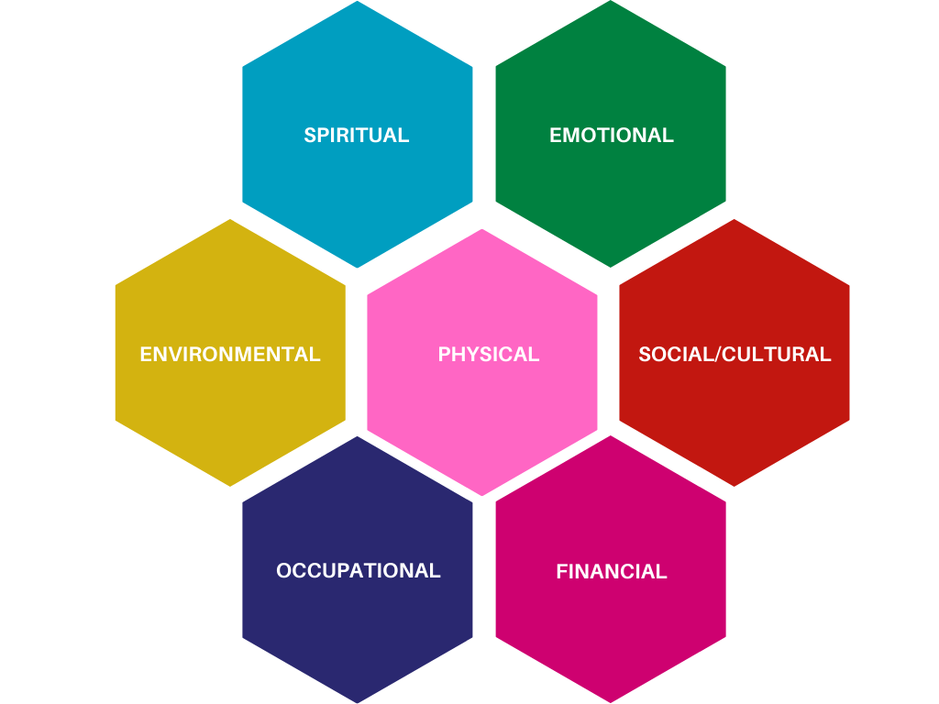
Notes:
TRAINER
“The seven dimensions of wellness is an approach to living a healthy and balanced life by recognizing the influences on our well-being. Even though these dimensions are listed separately, they are interconnected and influence one another.
These are the Seven Dimensions of Wellness that we will be using in this training program. Different organizations have different dimensions, some even have 8 or 9, but they will all generally refer to the following categories, even if they are labelled differently.
As we go through each of the seven dimensions, we will leave the discussion open so that we can all share some of the things we do to promote this specific dimension.
Spiritual: refers to our interest in the nature of human existence, and our awareness of our own principles and values.
Emotional: refers to our mental wellbeing. This includes being aware of the range of feelings we experience and expressing those emotions in a healthy way. However, it does not mean that we have to be positive or feel happy all of the time.
Environmental: refers to our sense of comfort in our physical surroundings, and our contributions to protecting the environment.
Physical: refers to the care of our physical bodies. This includes everything from eating nutritious food to engaging in physical activity and having a consistent sleep schedule.
Social/cultural: refers to our willingness to create healthy productive relationships and get involved in our communities.
Occupational: refers to our engagement in pursuits that provide us some form of personal satisfaction. This can be through work, volunteering, learning, or personal projects.
Financial: refers to our feelings of security or satisfaction concerning our finances.

Slide 15

In the blackest times of despair what’s needed first is hope as a light at the end of the tunnel, some idea that things can get better, that life will be more than the present destruction. Without hope there’s no real possibility of positive action. To be truly motivating, however, hope has to be more than just an ideal. It has to take form as an actual image of how things could be if they were to improve. It’s not so much that people will attain precisely the vision they create, since realistically most outcomes are products of chance and opportunity more than careful planning. But it does seem essential to have some clear image, if people are to make difficult changes and take positive steps.
Mark Ragins, MD “The Four Stages of Recovery”
Notes:
TRAINER
“This next slide is about hope. As a person with lived experience, a Peer Supporter can embody Hope for their Peer. Hope suggests that recovery is possible, as the Peer Supporter is proof of that.”
Read the definition of hope, or ask someone to read it out loud.

Slide 16
Breakout Room Activity
Module 2 – Recovery and Wellness
Write down your answer to the following question:
“What has supported you in doing the ‘hard work’ of Recovery; of rising to the challenge of recovering your mental health and well-being? What are the elements, ingredients and/or factors that have/continue to support your Recovery?”
Once you have completed this step (approx.
3-5 min), we will break out into smaller groups.
Note: You will also submit your answer to the trainers as part of your homework for this module.
Notes:
COORDINATOR
“Next we will be doing a small-group activity. The first part will be done independently. Write down an answer to the following question: What has supported you in doing the ‘hard work’ of Recovery; of rising to the challenge of recovering your mental health and well-being? What are the elements, ingredients and/or factors that have/continue to support your Recovery?
Now we will break into groups of three to share our responses. You will also submit your responses to the trainers as part of the homework for this module.”
You will have 5-10 minutes for this activity.

Slide 17
Resources
Module 2 – Recovery and Wellness
MHCC’s Guidelines for Recovery-Oriented Practice (June 2015)
This is a substantial document (98p.) that is broken up into six chapters, which correspond to six values:
Creating a Culture and Language of Hope
Recovery is Personal
Recovery Occurs in the Context of One’s Life
Responding to the Diverse Needs of Everyone Living in Canada
Working with First Nations, Inuit and Metis
Recovery is About Transforming Services and Cultures
Wellness Recovery Action Plan
This is a self-designed prevention and wellness tool that you can use to get well and stay well. https://mentalhealthrecovery.com/; Video about WRAP: https://www.youtube.com/watch?v=pMohYei4Qjo
Notes:
COORDINATOR
Read the Resources available but be clear that these are not required readings.

Slide 18
Homework (Part 1 of 2)
Module 2 – Recovery and Wellness
For Next Time:
Please watch Al Strong’s Presentation “History of Peer Support.”
The video is 48 minutes 27 seconds. We will have time at the beginning of the next module to discuss the video and any questions/comments you may have.
https://vimeo.com/488324439
Notes:
COORDINATOR
Introduce the homework for next time and ask what questions people have. Thank everyone for their attendance and engagement.

Slide 19
Homework (Part 2 of 2)
Module 2 – Recovery and Wellness
For Next Time:
Please submit your answers to the following questions:
“What has supported you in doing the ‘hard work’ of Recovery; of rising to the challenge of recovering your mental health and well-being? What are the elements, ingredients and/or factors that have/continue to support your Recovery?”
Also, submit your definition of Recovery/Wellness.
Notes:
COORDINATOR
Introduce the homework for next time and ask what questions people have. Thank everyone for their attendance and engagement.

Slide 20
Thank You
Notes:
TRAINER

